Slide 1



ITALY-1
Garci hotel Mediterraneo: https://www.europeanjobdays.eu/it/node/314792
Regione FVG: https://www.europeanjobdays.eu/en/company/servizi-pubblici-limpiego-regione-autonoma-friuli-venezia-giulia
Regione Liguria: https://www.europeanjobdays.eu/en/company/centri-limpiego-la-spezia
https://www.europeanjobdays.eu/en/company/centri-limpiego-imperia
Regione Marche: https://www.europeanjobdays.eu/en/job/aiuto-cuoco-esperto-experienced-assistant-cook-cod-312321
https://www.europeanjobdays.eu/en/company/regione-marche-centro-limpiego-di-pesaro
https://www.europeanjobdays.eu/en/company/regione-marche-cpi-ascoli-piceno
Regione Toscana: https://www.europeanjobdays.eu/en/company/centro-limpiego-di-firenze-arti-agenzia-regione-toscana-impiego

Slide 2
ITALY-2
Regione Abruzzo:
https://www.europeanjobdays.eu/en/company/centri-limpiego-regione-abruzzo
Regione Puglia
https://www.europeanjobdays.eu/it/node/316772
https://www.europeanjobdays.eu/en/company/centro-impiego-di-lecce
https://www.europeanjobdays.eu/en/company/centro-impiego-di-martina-franca
https://www.europeanjobdays.eu/en/company/centro-limpiego-gallipoli
https://www.europeanjobdays.eu/en/company/human-company
Stand Italy:
https://www.europeanjobdays.eu/en/job/stagione-primavera-estate-2022-germania-cuochi-camerieri-barman-receptionist-inservienti
https://www.europeanjobdays.eu/en/job/lavorare-irlanda-nella-ristorazione-e-accoglienza-alberghiera
https://www.europeanjobdays.eu/en/job/skipper
https://www.europeanjobdays.eu/en/company/tabarka-40-srls
Job italia:
https://www.europeanjobdays.eu/en/job/cookassistant-cook
https://www.europeanjobdays.eu/en/job/hotel-porter-rome; https://www.europeanjobdays.eu/en/job/experienced-waiter-rome-new-year-event; https://www.europeanjobdays.eu/en/job/room-attendant-rome

Slide 3
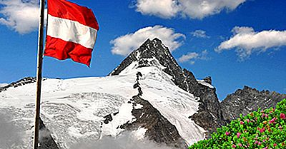
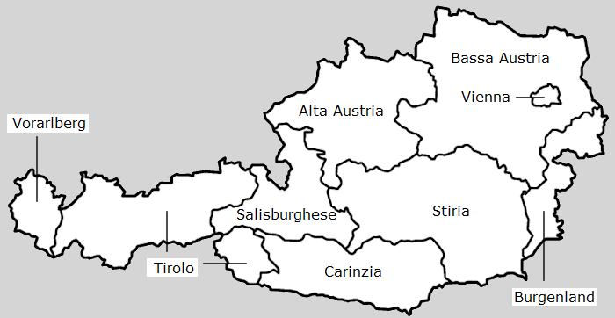


AUSTRIA-1
Vayagroup: https://www.europeanjobdays.eu/it/node/309793
ExplorerHotels: https://www.europeanjobdays.eu/it/node/300605
Hotel Post Nauders: https://www.europeanjobdays.eu/it/node/299851
Hotel post am seeGmbH: https://www.europeanjobdays.eu/it/node/309294
Hotel Kinder and Gletscherhotel Hintertuxerof :
Schloss: https://www.europeanjobdays.eu/it/node/291766
Schloss Fiss Gmbh : https://www.europeanjobdays.eu/it/node/302764

Slide 4

AUSTRIA-2
AMS-EURES (PES offer):
AMS Salzburg: https://www.europeanjobdays.eu/it/node/42334
AMS Landeck: https://www.europeanjobdays.eu/it/node/89278
Austria: https://www.europeanjobdays.eu/it/node/266
EURES Tyrol: https://www.europeanjobdays.eu/it/node/308119

Slide 5

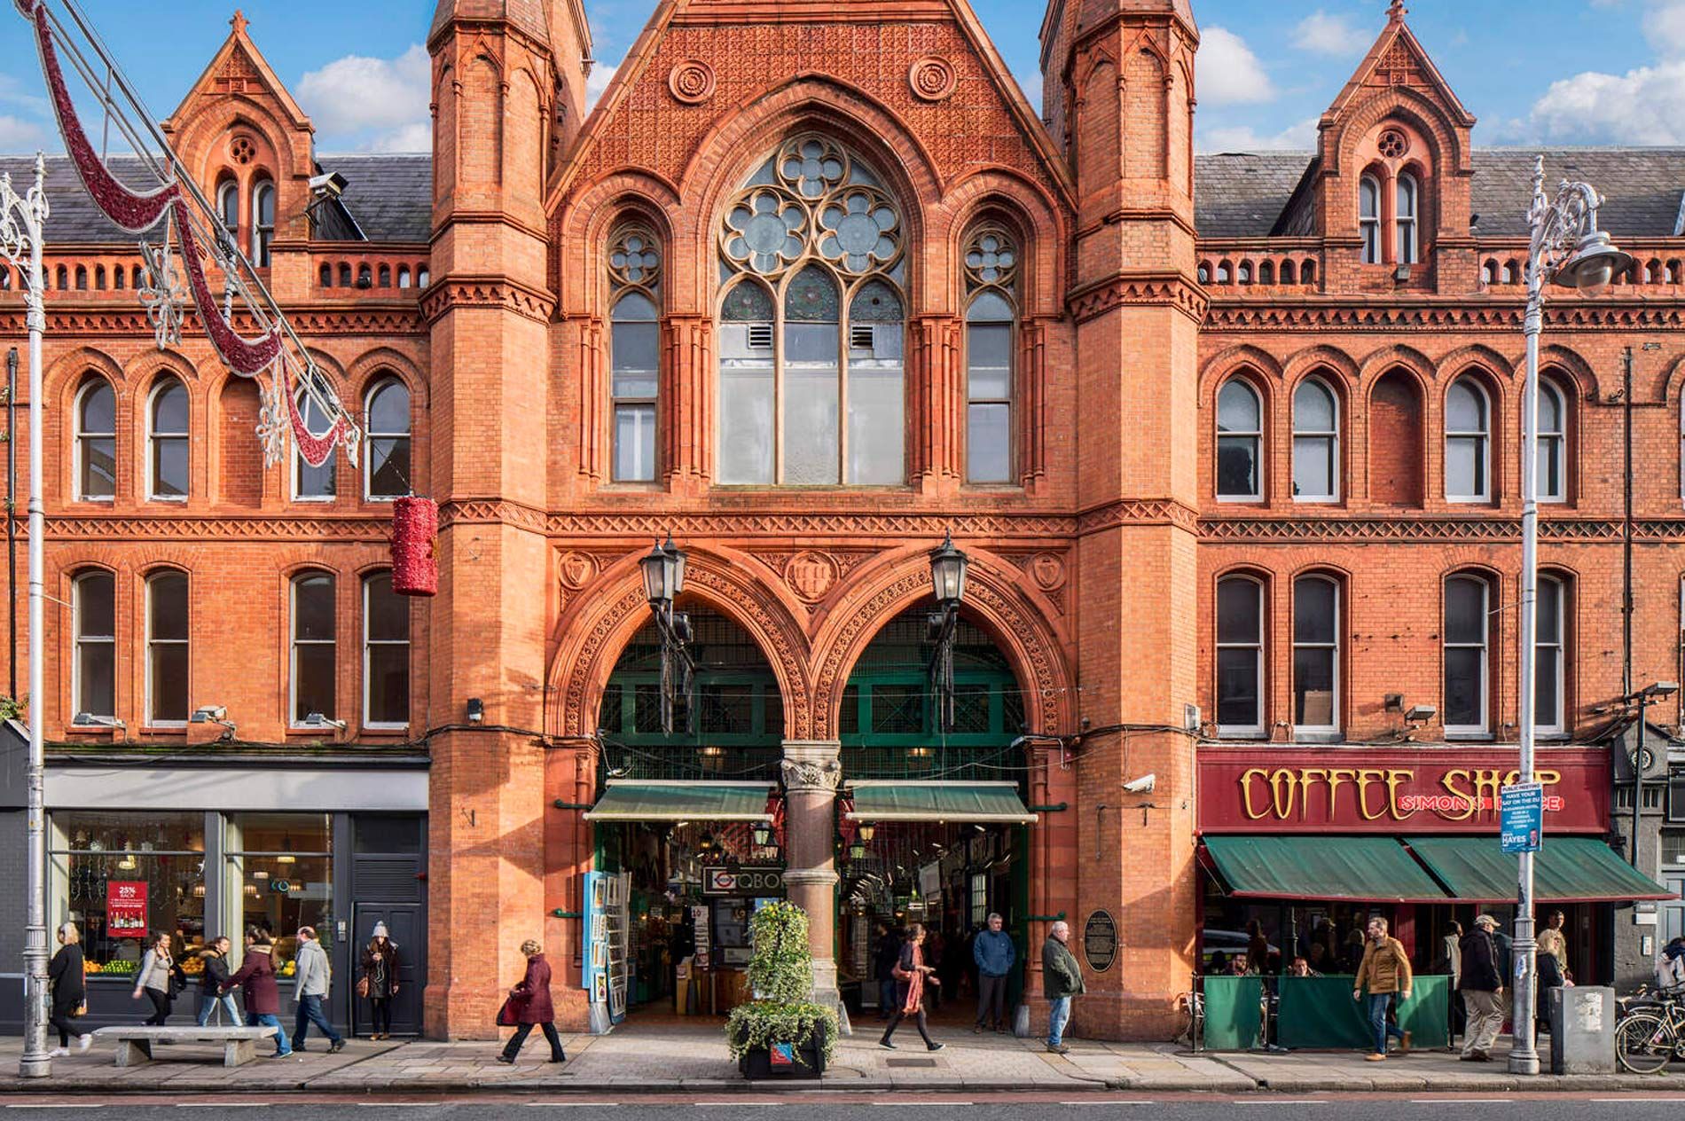
Ireland
Conrad hotel-Dublin https://www.europeanjobdays.eu/it/node/307349
Radisson blu Hotel:-Dublin
https://www.europeanjobdays.eu/it/node/137856
Dromolan Castle-County Clare
https://www.europeanjobdays.eu/en/company/cpi-pistoia
Ireland based but handled by cpi pistoia
https://www.europeanjobdays.eu/it/node/317185

Slide 6
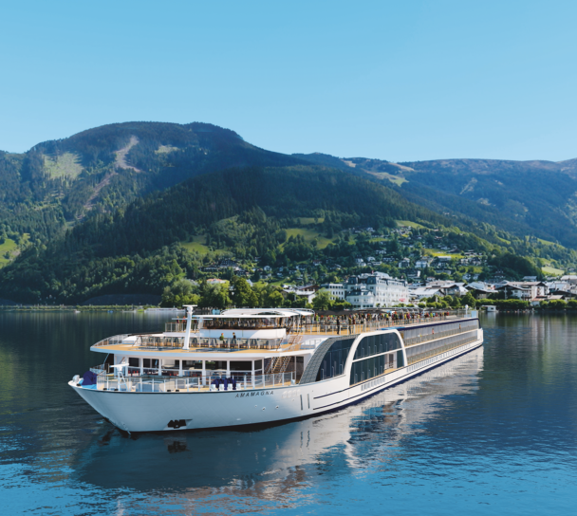
Cruise ships-1
Back-up jobs:
https://www.europeanjobdays.eu/en/company/backup-jobs-agency-sro
Hermes recruitment:
https://www.europeanjobdays.eu/en/company/hermes-recruitment

Slide 7
Entertainers :
Obiettivo Tropici:
https://www.europeanjobdays.eu/en/company/obiettivo-tropici
Your Friends Animazione:
https://www.europeanjobdays.eu/en/company/your-friends-animazione
Belgium: https://www.europeanjobdays.eu/it/node/314710
Cpi Pistoia: https://www.europeanjobdays.eu/it/node/313651
(Based in Germany and Ireland but already in the «Italy» stand)

Slide 8

Thank you for your attention!

