Slide 1





EURES ITALY EMPLOYERS' DAY 2021
2 December 2021
MobiliseSME: Mobility Exchange Programme for SME staff
Lorenzo Cello
Project Officer
Forum of the Adriatic and Ionian Chambers of Commerce (Forum AIC)
Il contenuto di questa pubblicazione riflette solo il punto di vista degli autori, cioè quello dei partner del progetto MobiliseSME. La Commissione Europea non è responsabile dell’uso che potrebbe essere fatto delle informazioni in essa contenute.
An initiative of the European Union

Slide 2
Brief introduction
Forum of the Adriatic and Ionian Chambers of Commerce
(Forum AIC)
The Forum AIC is a non-profit voluntary and transnational association that joins the Chambers of Commerce of the Adriatic and Ionian Region – 41 members so far
It was established in 2001 by the Marche Chamber of Commerce and Split Chamber of Economy
Permanent Secretariat at Marche Chamber of Commerce (Ancona)
Close cooperation with UniAdrion and FAIC. The so-called three civil society Fora together represent more than 130 institutions of the Adriatic Ionian Area (Integrated Secretariat)
Mission: strengthening synergies and opportunities for socio-economic development of the Adriatic Ionian Area

Slide 3


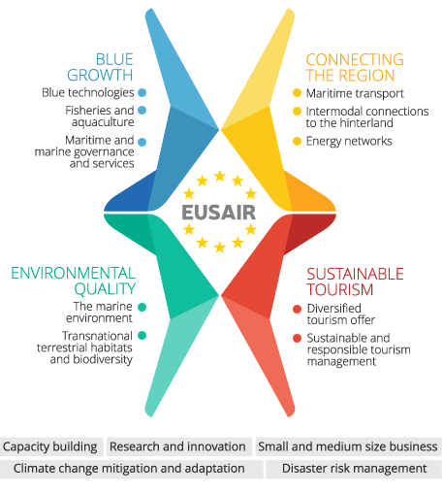



The AIC Forum in the European Strategy for the Adriatic-Ionian Region (EUSAIR)
Since their establishment - in the early 2000s - the three civil society FORA (Forum AIC, FAIC and UNIADRION) have been identified as major EUSAIR stakeholders
EUSAIR is a political framework that allows the 9 countries located in the same macroregion to tackle and solve problems or to better exploit the potential they have in common
EUSAIR 4 Pillars: Blue Growth; Connecting the Region (transport and energy); Environmental Quality; and Sustainable Tourism

Slide 4

WHY ARE WE HERE TODAY?
...Forum AIC is the only Italian contact point for MobiliseSME
www.mobilise-sme.eu
#MobiliseSME
The content of this publication reflects the point of view of the authors only, i.e. that of the partners of the MobiliseSME project. The European Commission is not responsible for any use that may be made of the information contained therein.
An initiative of the European Union

Slide 5


What is MobiliseSME?
European programme (pilot project running from August 2020 until July 2022 - probable extension).
Staff (employees, managers and owners or co-owners) from a SME (Sending Company) stays a short period of time (1-6 months) with another SME (Host Company) in another EU country.
Financial support is provided by the programme to cover accommodation and integration costs (length and location of the exchange).
Types of collaboration: market research or marketing strategies; development of products and services (innovation R&D): internationalisation, search of new clients and trade opportunities (Foreign Trade); training (Knowledge Transfer); joint research activities; strengthening pre-existent collaboration; other kind of collaborations.
There are no deadlines to participate. Ongoing assessment and participation.
Participating countries: EU Member States, Iceland and Norway, Albania, Republic of North Macedonia, Montenegro, Serbia and Turkey.
First EU Mobility Program
Designed for SMEs

Slide 6



Sending Company
Host Company
Employees, managers and owners or co-owners part of a SMEs (self-employed and
one-man enterprise are allowed) with 3
years of experience and 1 year employed in
the SME.
SMEs that are set up for longer than 1 year and that are willing to receive seconded employees.

Slide 7


Financial support
Country of stay / Host country | Amount per month / €
Albania | 530
Austria | 900
Belgium | 830
Bulgaria | 560
Croatia | 720
Cyprus | 780
Czech Republic | 610
Denmark | 1100
Germany | 830
Estonia | 670
Finland | 950
Republic of North Macedonia | 560
France | 900
Greece | 780
Hungary | 670
Iceland | 900
Ireland | 1000
Italy | 900
Latvia | 610
Lithuania | 560
Luxembourg | 830
Malta | 720
Montenegro | 560
Netherlands | 830
Poland | 610
Portugal | 780
Romania | 560
Serbia | 560
Slovakia | 610
Slovenia | 720
Spain | 830
Sweden | 950
Turkey | 750
United Kingdom | 1000
Employees with disabilities (regardless of the country of stay) | 1100

Slide 8
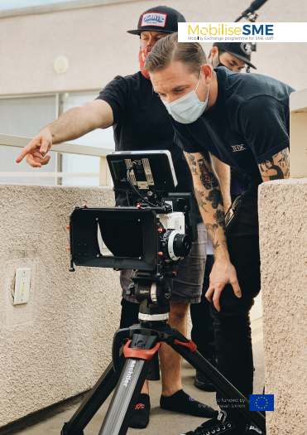
Why participate?
BENEFITS FOR THE SENDING COMPANY (SC):
A deeper understanding of a thematic area for both the SME and its employees (HR, marketing, finance, etc.)
Gain knowledge about other markets
Access to a technology, a specific method or innovation
New needed complementary skills for your employees, managers or owners
New skills international contacts, market intelligence or consolidation business with the hosting company
BENEFITS FOR THE HOST COMPANY (HC):
Gaining newer and fresher ideas from peers in your field
Further development of products and services for your SME
Opportunity to widen networks at EU level
Learn new technologies or skills from the seconded employee.
A chance for the expansion/consolidation of already existing business relations with the sender

Slide 9
How does it work?
1
2
3
4
5
ONLINE
APPLICATION
On the MobiliseSME website
MATCHING
Done through the matchmaking platform and the assistance of local information points
CONTACTING &
PREPARATION
PHASE
STAY ABROAD
From 1 to 6 months
FEEDBACK &
FINAL PAYMENT
www.mobilise-sme.eu

Slide 10
3
CONTACTING & PREPARATION PHASE
1
ONLINE APPLICATION
Activity Plan: detailed information about the activities and projects during the exchange.
All parties involved in the development.
Arrangements and documents for the stay abroad.
Registering in the Matchmaking platform is compulsory.
SME Declaration to be signed (provided by the
MobiliseSME).
Participating countries: EU member States; Iceland
and Norway; Albania, Republic of North Macedonia,
Montenegro, Serbia and Turkey.
4
STAY ABROAD
2
MATCHING
Duration: 1-6 months.
Always supported by the Local Contact Point.
SMEs may boost existing collaborations thanks to the
MobiliseSME programme.
Interested SMEs may also search for partners out of the platform.
Local contact points may provide assistance. They shall assess the match and approve it.
5
FEEDBACK & FINAL PAYMENT
Local Contact Points will assess the secondment.
Final Survey is compulsory before the final payment.

Slide 11
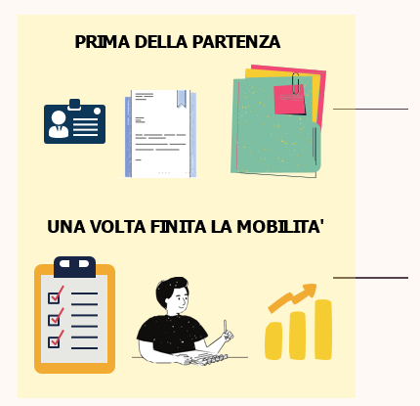

Requested documents
IDENTITY DOCUMENT
CURRICULUM VITAE
SME MOBILISE DECLARATION
ACTIVITY PLAN
FINANCIAL AGREEMENT
FEEDBACK SURVEY
WRITTEN INTERVIEW
MOBILITY SUCCESS STORY
An initiative of the European Union

Slide 12
How does the FORUM support?
PROVIDES INFORMATION TO PARTICIPANTS BEFORE DEPARTURE
SUPPORT IN THE CREATION OF MATCHES AND COORDINATION WITH THE LOCAL CONTACT POINT OF THE OTHER SME
SUPPORT IN THE REALIZATION OF THE ACTIVITY PLAN
GUARANTEES THE MONTHLY CONTRIBUTION TO THE SENDING COMPANY ACCORDING TO THE FINANCIAL AGREEMENT
CONTINUOUS EVALUATION OF THE ROUTE TO ACHIEVING THE OBJECTIVES
SUPPORT TO RETURN FROM MOBILITY
An initiative of the European Union

Slide 13
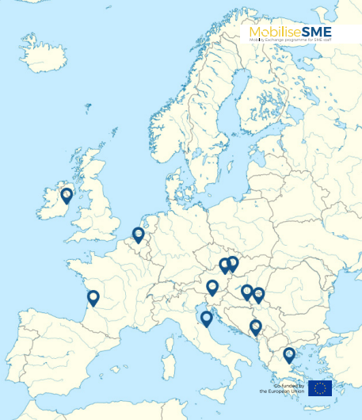
Local Contact Points
Mobilise SME considers applicants properly established and registered in the following countries:
EU Member States.
Iceland and Norway in accordance with the EEA Agreement.
Albania, Republic of North Macedonia, Montenegro, Serbia and Turkey.

Slide 14
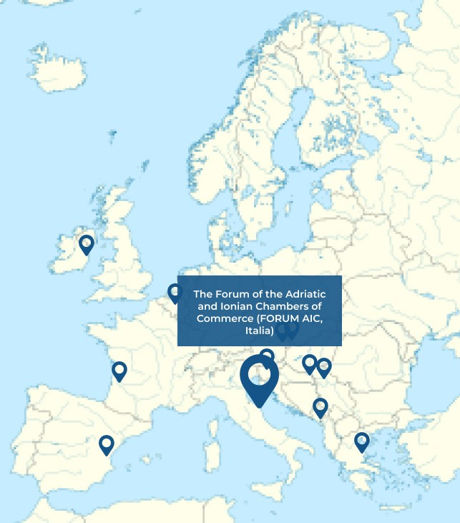


Your Contact Point in Italy
The Forum of the Adriatic and Ionian
Chambers of Commerce
www.forumaic.org
segreteria.forum@marche.camcom.it
Eleonora Tramannoni
eleonora.tramannoni@marche.camcom.it
Alina Nistor
alina.nistor@marche.camcom.it
www.forumaic.org
Lorenzo Cello
lorenzo.cello@marche.camcom.it
An initiative of the European Union

Slide 15



THANKS!
Look up for news, updates and stories about MobiliseSME on Twitter, LinkedIn and Facebook
For more information you can contact me at lorenzo.cello@marche.camcom.it

