Slide 1
EURES Targeted Mobility Scheme
(EURES TMS)
15 March 2021- 14 March 2023
EURES ITALY Employers’ Day
02.12.2021
Germana Monaldi
EURES TMS Operational manager
ANPAL
Notes:
dfgsdgadfgadgfsdgfdfgadfg

Slide 2


The EURES Network

Slide 3

EURES – EURopean Employment Services
The European cooperation network of employment services, aims to facilitate the free movement of workers
Launched in 1994!
Around 1.000 EURES Advisers
in Europe
The EURES portal
ec.europa.eu/eures

Slide 4

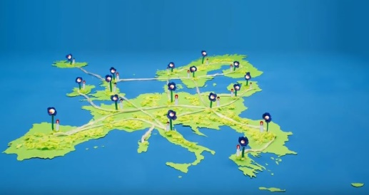




THE EURES SERVICE
EURES Portal
EURES staff
EOJDs
Job seekers
employers
Living and working conditions in EU
Professional mobility
Job Matching
FREE of CHARGE!

Slide 5
THE EURES TARGETED MOBILITY SCHEME PROJECT
(EURES-TMS)

Slide 6

Objective: a mix of services and financial benefits
Information
Tailored services and counselling
(EURES)
High quality employers and vacancies
Financial
Benefits
… to support employability and employment in the EU!

Slide 7



What’s new about the TMS Programme
A targeted mobility scheme that brings together the previous experiences of YfEj (< 35 y.o.) and Re-activate (> 35 y.o.) in one project
EU citizens but also third country nationals with EU long-term resident status in a EU country, plus Norway and Iceland
Increase in the amount of financial benefits and... a new benefit for relocating a family member
+

Slide 8

What’s new about the EURES TMS project
+
Enlargement of the partnership with Pôle Emploi (FR), EURES Malta, and two language schools: CLL Belgium and Language Lab (IT)
E-learning platform of language courses and preparatory training to support mobile workers
Candidates’ community aimed at sharing and enhancing the experience of the participants
Network of employers aimed at consolidating the experience and involving new employers in EURES TMS

Slide 9


The «bag» of experience…
The experience of pilot actions: empowerment workshops for candidates
Kit of tools to guarantee the quality of traineeships
Top EURES employer Label, awarding employers who offer high quality mobility standards in traineeship experience
Final employer declaration about the experience, tasks performed and training received (for all participants)

Slide 10
The Partnership
EURES offices, national and international public and private bodies, language schools, a University, a employers representative body, a EU network and the EURES Italian network
Most together since 2015!
Lead Applicant
EURES Italia-ANPAL
Co-applicant
CLL (BE), CMRC (IT), Dian (GR,)Eurodesk (IT), FGB (IT), Uniroma (IT), EURES Bulgaria, EURES Cyprus, EURES France, EURES The Netherlands, EURES Portugal, EURES Romania, EURES Spain
*Affiliate
Capitale Lavoro
Associates
EURES Croatia, EURES Malta, Employment regional centre DWUP (PL), Regional centre in Olsztyn (PL), Language Lab (IT), Unioncamere (IT),
+ All Italian EURES Network

Slide 11
Who can apply
Candidates
Aged over 18 y.o.
EU resident and citizen + Norway and Iceland
Third country nationals with EU long-term resident status in EU countries + Norway and Iceland
Interested in moving to another country for a job, apprenticeship or traineeship
Employers
SMEs or large size organisations, profit and no-profit ones
With registered office in one of the EU + Norway and Iceland countries
In compliance with national legislation
offering …
Traineeships of at least 3 months
Employment and apprenticeship contracts of at least 6 months

Slide 12
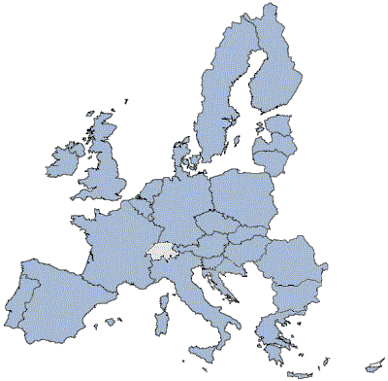
















Which countries and economic sectors?
FLOWS FROM ALL COUNTRIES TO ALL COUNTRIES!
ALL ECONOMIC SECTORS …
BUT SOME OFFERS MORE OPPORTUNITIES!
Social and Health care
Scientific and Technical activities
Tourism and associated sectors
ICT
Education

Slide 13
Services addressed to Candidates
Information, guidance, workshop (cv writing, job interviews, skills strengthening)
Support for project and benefit enrollment and access
Direct and personalized counselling (telephone, in front/online interviews)
Recruitment days
Support in the transfer/post-placement phase in the country of destination

Slide 14
Services addressed to Employers
Database of CVs from all over Europe
Information, workshop, recruitment days
Identification of needs and support to define the job offer
Support in the registration process (possibility to delegate a project Adviser to operate on the platform)
Candidates pre-selection and matching
Organisation of interviews with the candidates
Support in the definition of the integration program (SMEs)

Slide 15

Measures and financial benefits
Candidates
Employers
Job interviews
Up to 660 €
Suppl. interview/relocation allowance
Up to 1.100 €
Traineeship/apprenticeship integration
Up to 660 €/m for 6 months
SMEs only
Integration Program
(basic or comprehensive)
for new employed
Up to 2.000 €
for each worker
Language course
Up to 2.200 €
Transfer to another country for oneself and family
Up to 1.540 €*2
Recognition of qualifications
Up to 440 €

Slide 16
Expected results
Candidates
Job interviews: 1.460 candidates
Relocation for work/traineeship/apprenticeship: 2.500 recruited candidates (out of which 75 benefit from additional support for the transfer of the family)
Language courses (in front/on line): 1.200 candidates
Recognition of qualifications: 290 candidates
Supplentary allowance for specific needs (interview and/or transfer): 140 candidates
Integration for trainees/apprentices: 100 recruited candidates
On line language courses and preparatory training: 50+500 pre-selected/recruited candidates
Employers
680 recruited candidates as beneficiaries of an integration program offered by the employer

Slide 17

How to participate in EURES TMS?
Empl side
16

Slide 18
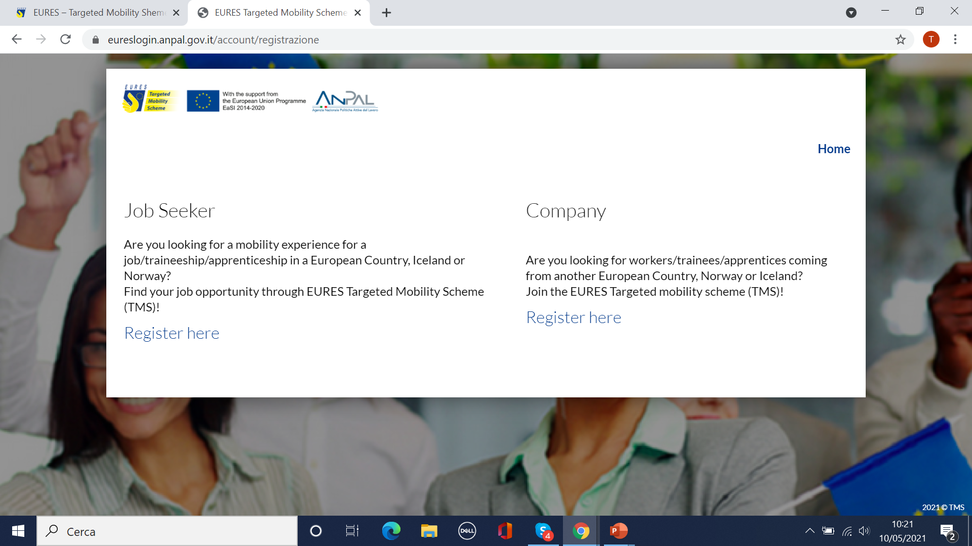

STEP 1: EMPL registers himself in the platform
EURESmobility.anpal.gov.it

Slide 19

STEP 2: EMPL validates the email address and receives a welcome email
Dear (employer contact person),
thank you for registering in EURES TMS project. The project team is checking the data you provided with.
You will receive by e-mail the credentials to access to your personal dashboard.
If necessary, you can contact the Project team for more information or clarification about the Company/Organisation eligibility in the project.
Best regards,
The project team
EURES National Coordination Office Italy

Slide 20
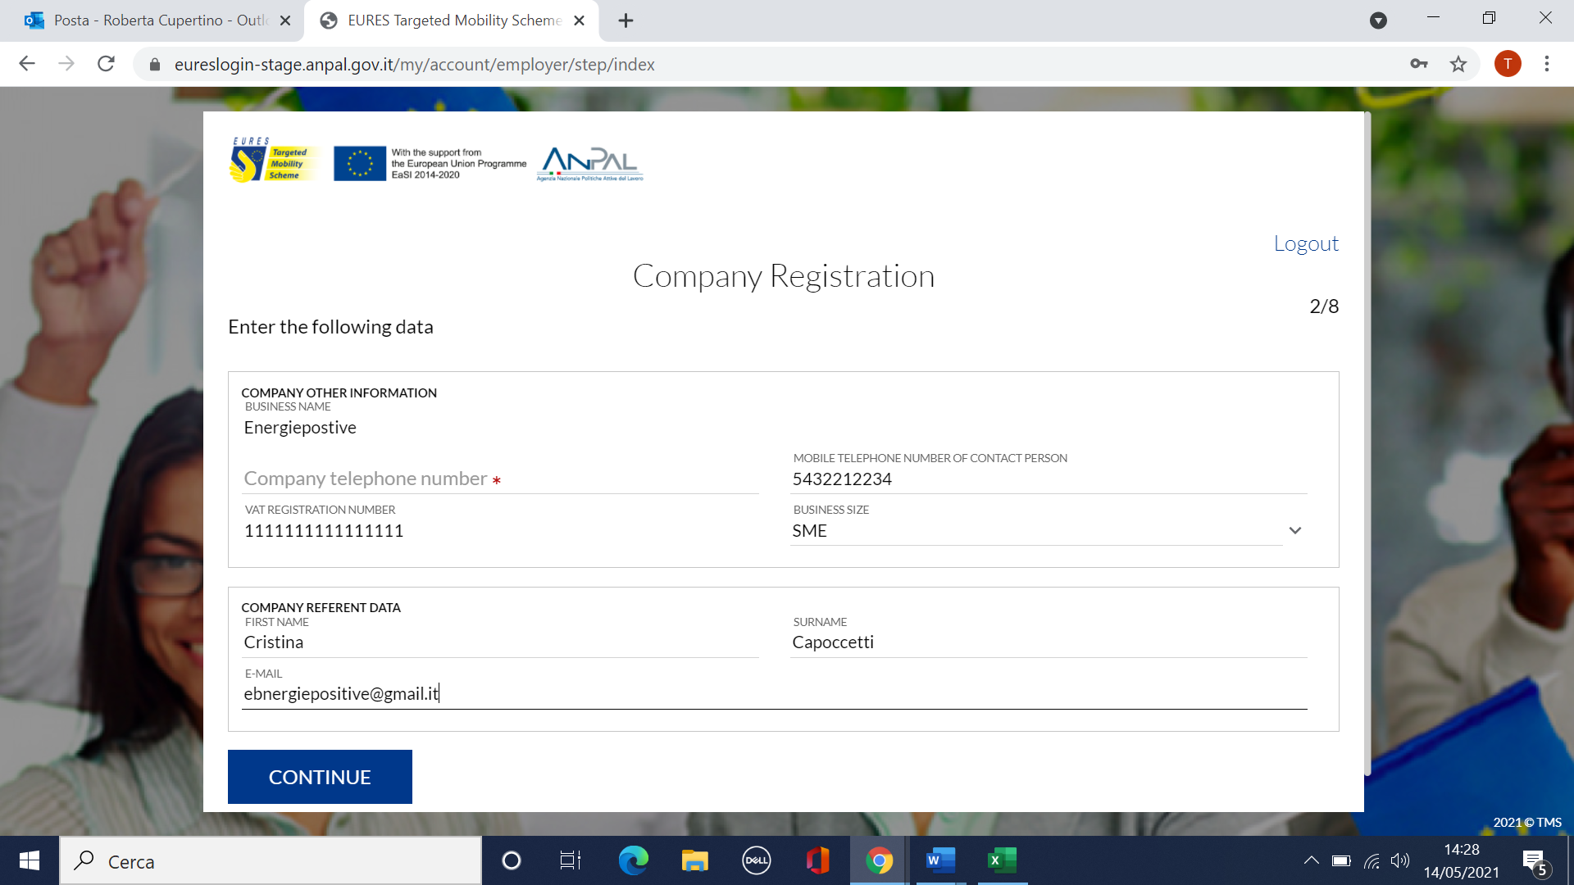
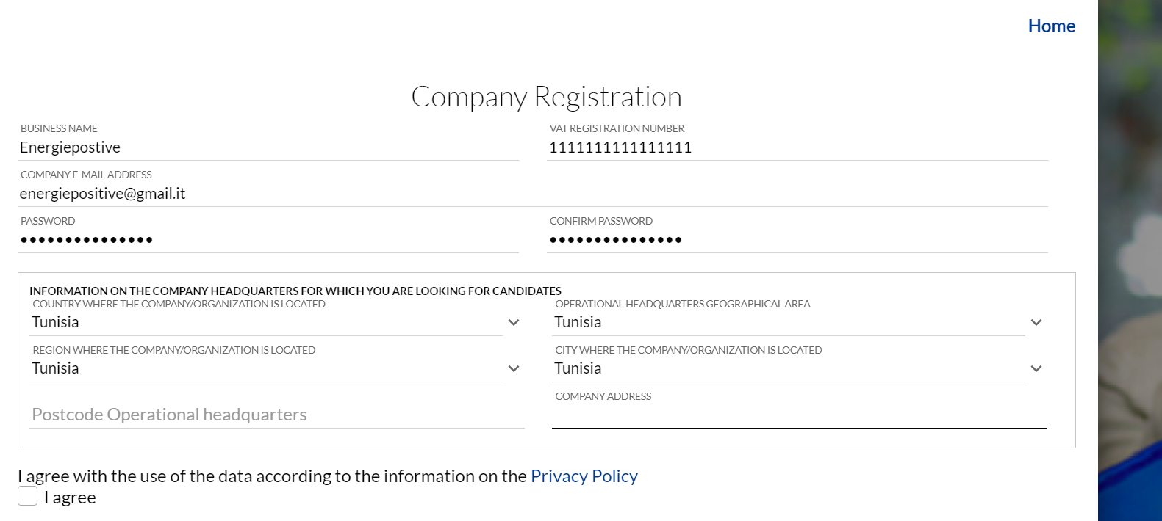
STEP 3: EMPL fills in the registration form

Slide 21


STEP 4: ANPAL help desk validates the Company and assigns it to a project Adviser
Dear (Company name),
thank you for registering in the platform and welcome to EURES TMS project, run by the EURES National Coordination Office Italy (link a https://www.anpal.gov.it/eures-en) and financed by the EU Programme for Employment and Social Innovation (EaSI) (link a https://ec.europa.eu/social/main.jsp?catId=1081).
The project supports the mobility of workers across European countries and in some EEA countries (Norway and Iceland), through financial benefits and services addressed to jobseekers and employers.
Your Company profile in the platform is validated and starting now you can access to your dashboard!
A project Adviser will shortly get in touch with you and will support you to fill in your vacancies, to select candidates and to manage the project procedures.
Please do not hesitate to contact us at EURES-TMS@anpal.gov.it mail for any clarification or further information.
Best regards,
The project team
Dear (Company name),
In every moment you can access your dashboard in the EURES-TMS project platform and benefit from its services.
A EURES TMS project Adviser will shortly get in touch with you and support you with the next steps. Find below the contact details:
Name and Surname (nome e cognome Adviser)
Telephone (telefono adviser)
E-mail (e-mail adviser)
We take the opportunity to inform you that you can delegate the management of the project procedures in the platform (e.g. Integration Programme request, Integration Programme payment) to your Adviser, by clicking on.....................
Please, be aware that you or your delegated are the only ones entitled to sign applcation (you can not delegate the signature to a project Adviser).
Do not hesitate to contact us at EURES-TMS@anpal.gov.it if you for any clarification or further information.
Please, inform us by e-mail if you are not contacted within 15 days of receiving this message.

Slide 22
How to participate in EURES TMS?
JS side
21

Slide 23
STEP 1: JS registers in the platform
EURESmobility.anpal.gov.it

Slide 24


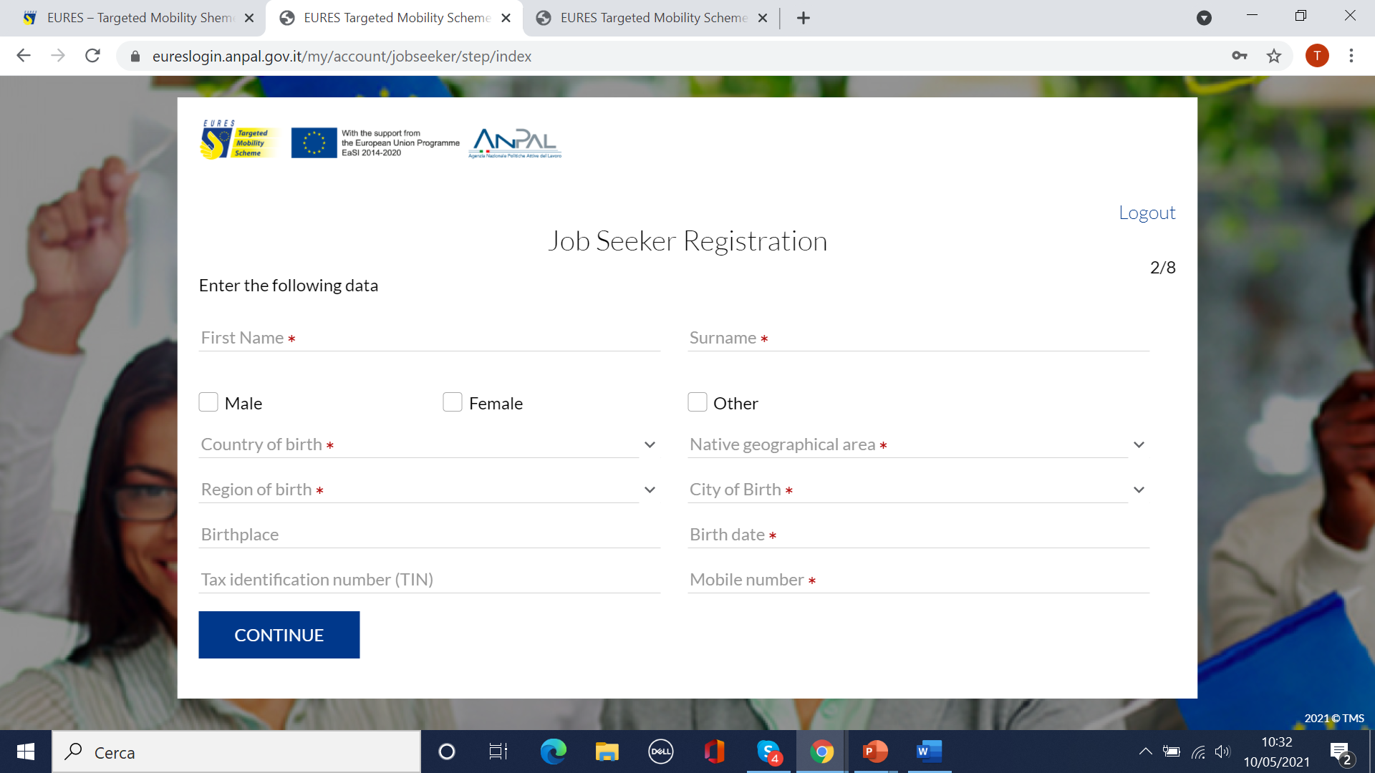
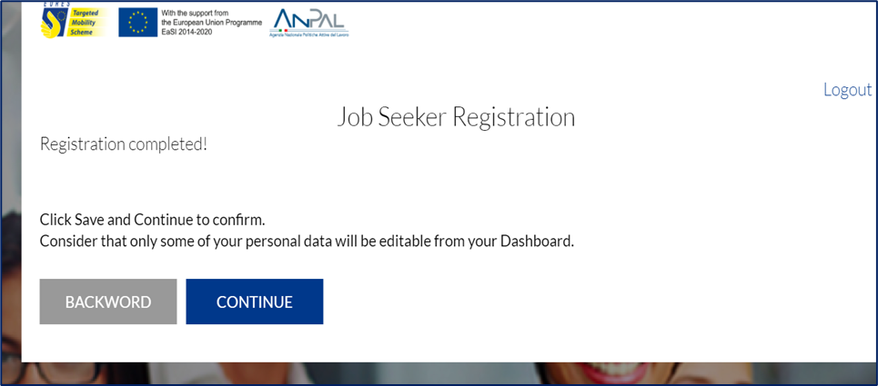
JS validates the email (to guarantee data security) and fills in the registration form

Slide 25
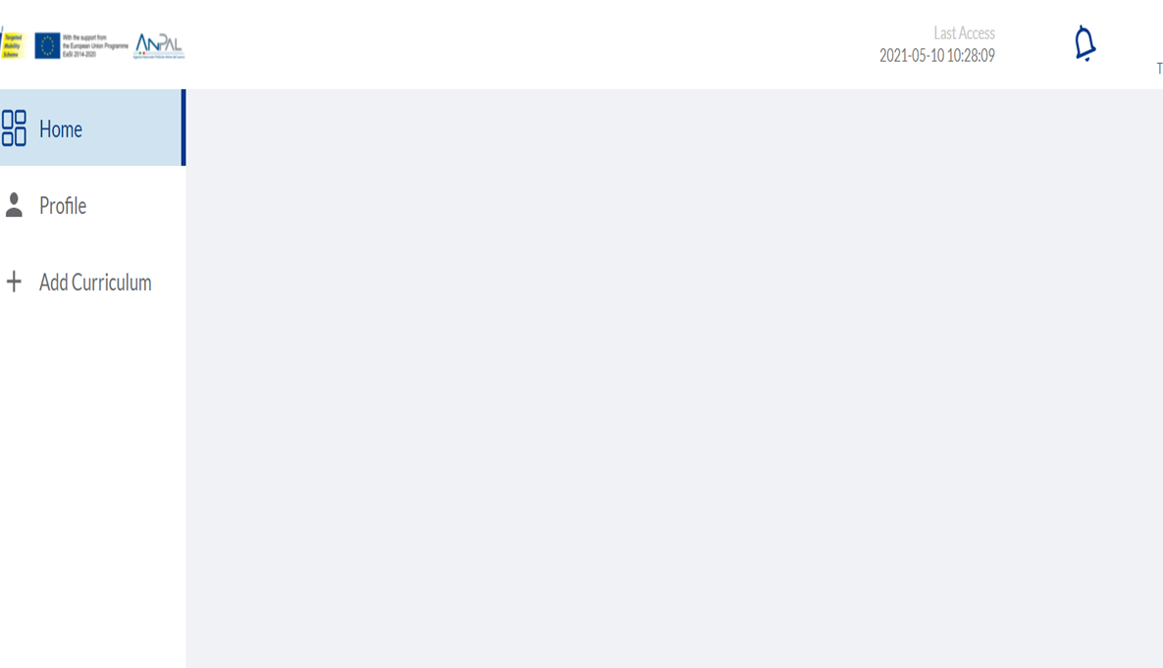
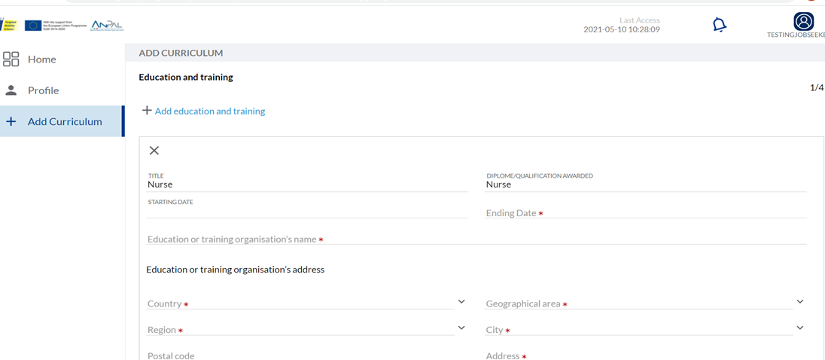
STEP 2: JS fills in her/his curriculum online
Highly recommended: candidates curriculum and suitable position have to be updated: any information might be important to be selected

Slide 26
What happens next?
5 ways to be selected in EURES TMS
25

Slide 27






Case 1: Suitable candidates are contacted by the Adviser
Employer
Project Adviser
Vacancy
1. Checks e validates the vacancy
2. Selects suitable profiles through the platform
3. Contacts candidate/s through the EURES TMS

Slide 28
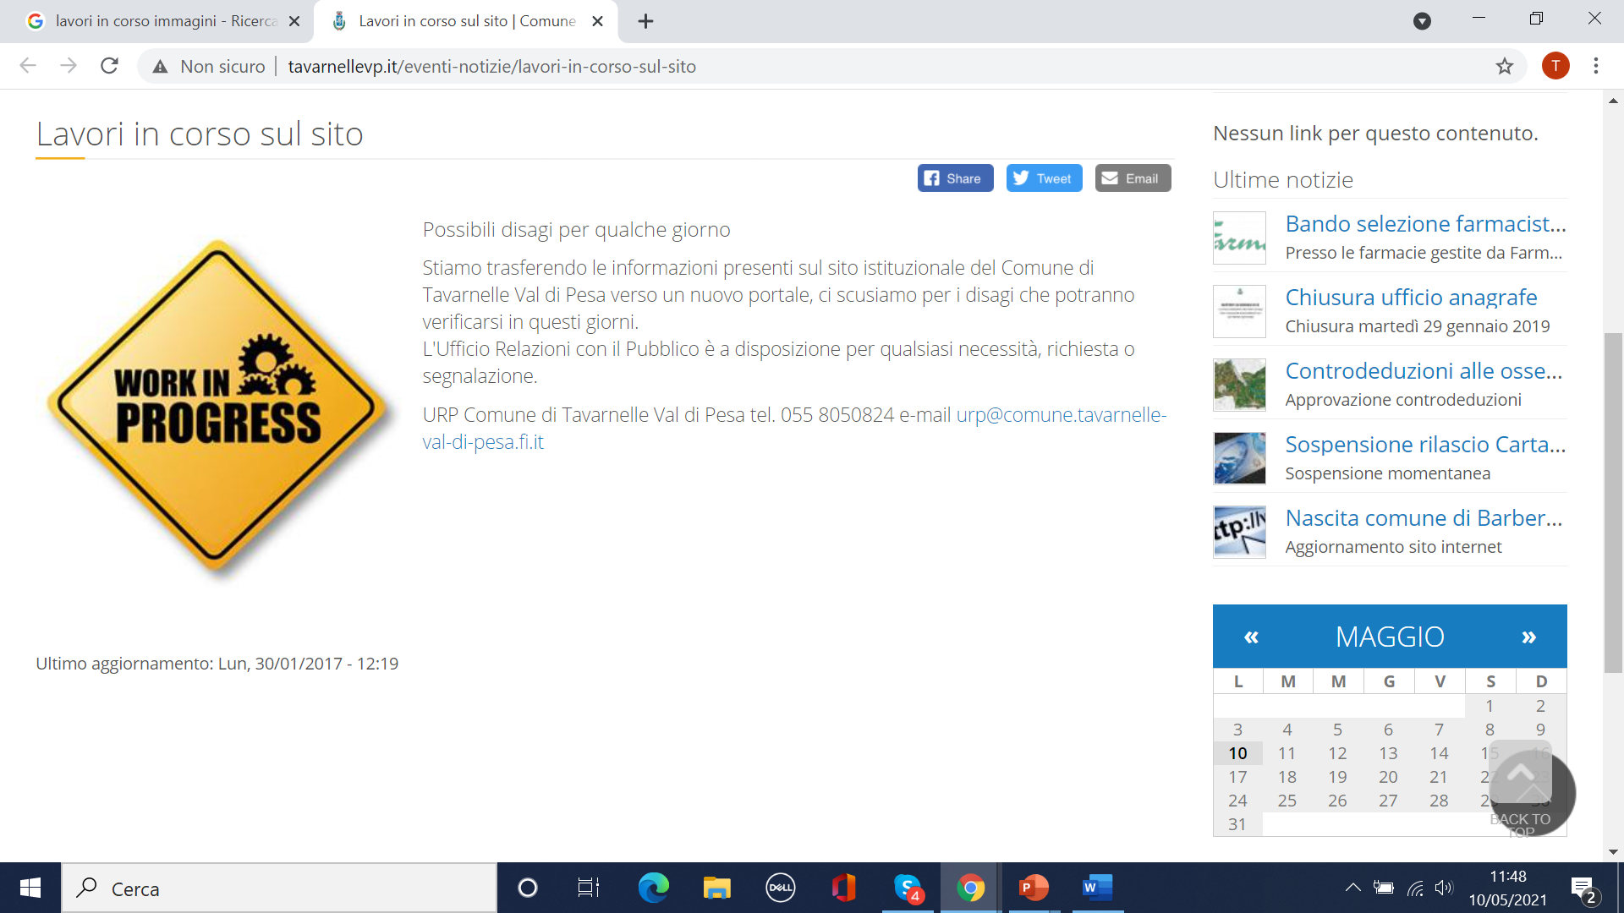
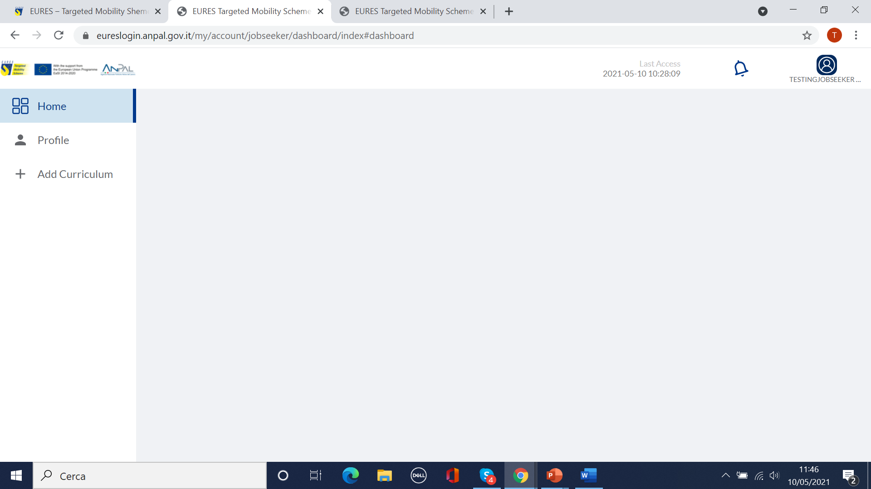
Case 2: Candidates find suitable vacancy/es in their dashboard
Platform matches the available vacancies with candidate/s desired positions. Suitable vacancies are showed to candidates in their dashboard
Please note: publishing vacancies helps adviser/s find suitable candidates

Slide 29
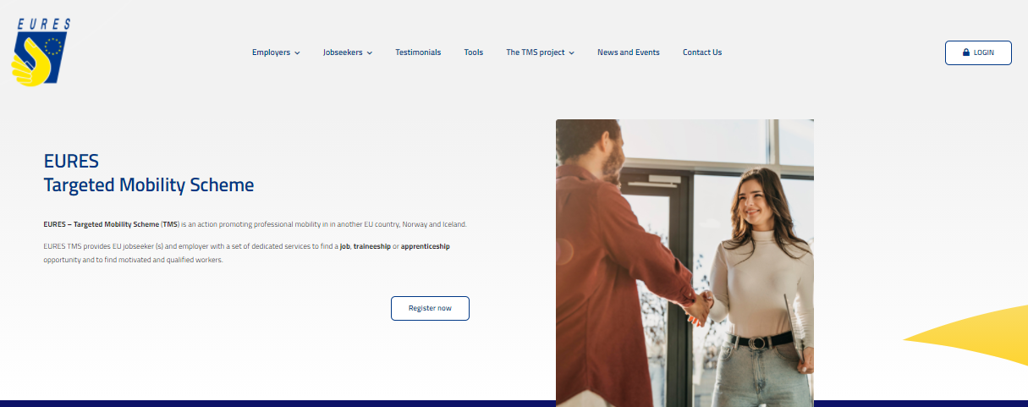
Case 3: Looking for positions in the project website/social media
Are Adviser/s looking for candidate/s and/or are there receiving any candidate/s application (or few) through the platform? Write to the Anpal help desk and promote the vacancy/es on the project site/channels!
Vacancies published through EURESmobility.anpal.gov.it offer a high number of positions or require specific profiles for hard to fill vacancy/es
Adviser will fill in a vacancy form in order to promote the vacancy/es

Slide 30

Case 4: Looking for vacancy through the EURES portal
Candidate/s finding positions can contact Adviser/s or the project staff to be supported by the EURES TMS project

Slide 31



Case 5: Candidate is already in touch with an Employer
Candidate/s
Partner address or
EURES-TMS@anpal.gov.it
Employer not yet registered
EURES TMS project Adviser

Slide 32

Applications flows and checks
31

Slide 33
EURESmobility.anpal.gov.it platform
JOB SEEKER
EMPLOYER
PROJECT
ADVISER
PROJECT STAFF
registration
registration
invitation employer
enabling Advs
CV and desired occupation
JV (proxy Adv possible)
JV validation
employers validation and assignement Adv
matching procedures
matching procedures
preselection
2° level check applications
applications for financial benefits
invitation JS (interview)
matching procedures
authorisation/ payment
integration programme questionnaire
application for integration programme (PMI)
1° level check application
monitoring

Slide 34

What’s new in EURES TMS platform?
Data security guarantee (EU and Italian legislation)
Use of artificial intelligence (automatic JV matching with desired JS position)
Electronic signature ( OTP - One Time Password )
Additional features to easy navigation and flows / procedures
Automatic checks (data, applications, flows, etc.)
External email /messaging
Interoperability with EURES portal (for CVs)

Slide 35



How access to benefits (Candidates)
Employer
Candidates
Project Adviser
Vacancy
Pre-selection phase
Language course
Relocation+ family member
Interview allowance
Special needs
(Relocation)
Special needs
(Interview)
Integration to subsistence allowance for trainees/apprentices
Recognition of qualification
Recruitment phase

Slide 36

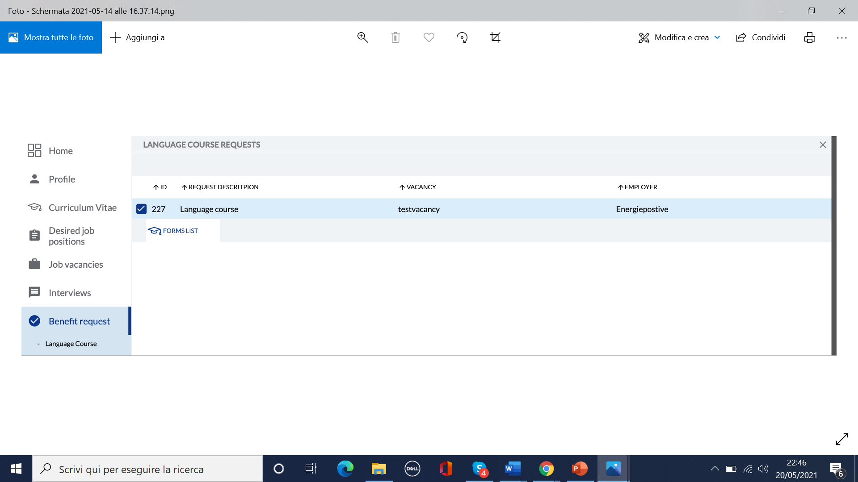
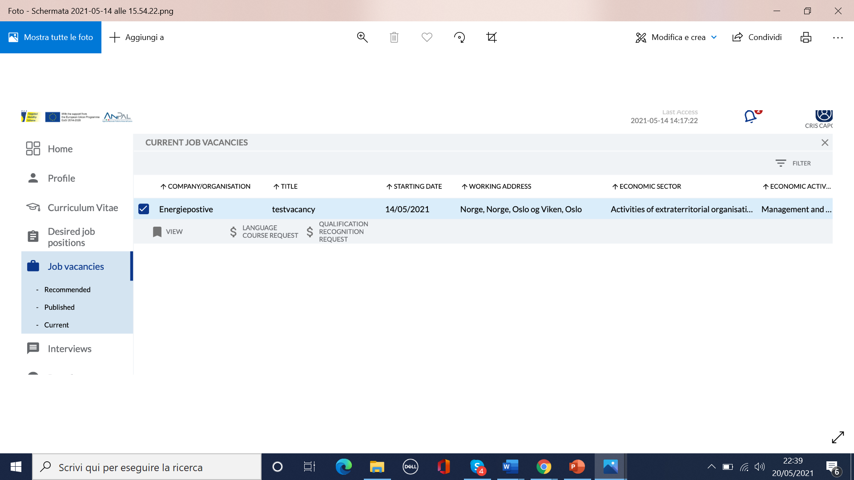
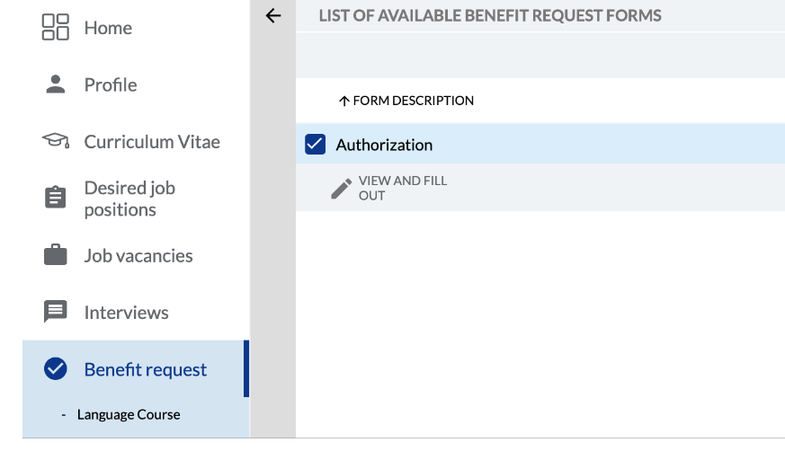
Application flow for all measures
2. Then JS fills in the application form thorugh the benefit request area
1. Financial benefit is activated through the vacancy area

Slide 37


Checks on benefit applications
1. Project Adviser 1° check
2. Project staff 2° check
3. Project staff provide the financial benefit
1.

Slide 38

To read more and be informed?
37

Slide 39
Project web site and social media
Site: EURESmobility.anpal.gov.it
Central Help desk: EURES-TMS@anpal.gov.it
Facebook: @ EURESmobilityTMS
Twitter: @EURES_TMS
LinkedIn: EURES Targeted Mobility Scheme
Instagram: EURES_Targeted_Mobility_Scheme

Slide 40
Thank you for your attention!

